Slide 1
PYTHON

Slide 2
MODULE – 3 DATA SCIENCE WITH
PYTHON

Slide 3
AGENDA
In this module, we will discuss about the following:
Python basics
Variables types
Data types
Libraries
Python with Hadoop and Spark

Slide 4
PYTHON BASICS

Slide 5
PYTHON BASICS
INTRODUCTION
The programming language Python was conceived in the late 1980s, and its implementation was started in December 1989 by Guido van Rossum
The Python language has many similarities to Perl, C, and Java.
There are some definite differences between the languages.
Python provides no braces to indicate blocks of code for class and function definitions or flow control.
Blocks of code are denoted by line indentation, which is rigidly enforced.

Slide 6
VARIABLE TYPES

Slide 7
PYTHON VARIABLE TYPES
Variables are nothing but reserved memory locations to store values. This means that when you create a variable you reserve some space in memory.
Based on the data type of a variable, the interpreter allocates memory and decides what can be stored in the reserved memory.
By assigning different data types to variables, you can store integers, decimals or characters in these variables.
EXAMPLE:
x = 5 y = "John” #where x and y are called as variables.

Slide 8
DATATYPES

Slide 9
PYTHON DATA TYPES
Everything is an object in Python programming, data types are actually classes and variables are instance (object) of these classes. Python has five different data types. They are as follows:
NUMBERS
Number data types store numeric values.
Number objects are created when you assign a value to them.
EXAMPLE:
var1 = 1
var2 = 10

Slide 10
PYTHON DATA TYPES
2. STRING
Strings in Python are identified as a contiguous set of characters represented in the quotation marks.
Python allows for either pairs of single or double quotes.
EXAMPLE:
str = 'Hello World!‘
3. LIST
List is a compound data type in python and it is similar to arrays in C language.
A list contains items separated by commas and enclosed within square brackets ([]).
EXAMPLE:
list = [ 'abcd', 786 , 2.23, 'john', 70.2 ]

Slide 11
PYTHON DATA TYPES
TUPLE
A tuple is another sequence data type that is similar to the list.
A tuple consists of a number of values separated by commas and enclosed within parenthesis ( () ).
EXAMPLE
tuple = ( 'abcd', 786 , 2.23, 'john', 70.2 )

Slide 12
PYTHON DATA TYPES
DICTIONARY
Python's dictionaries are kind of hash table type.
Dictionaries are enclosed by curly braces ({ }) and values can be assigned and accessed using square braces ([]).
They work like associative arrays and consist of key-value pairs.
KEY : Any Python type, but are usually numbers or strings.
VALUES : Any arbitrary Python object.
EXAMPLE:
dict = {}
dict['one'] = "This is one"
dict[2] = "This is two"

Slide 13
PYTHON LIBRARIES

Slide 14
AGENDA
In this topic, we will learn about the following:
Numpy
Scipy
Pandas
Scikit Learn
Visualization
- Matplotlib

Slide 15
PYTHON LIBRARIES FOR DATA SCIENCE
Python library is a collection of functions and methods that allows you to perform many actions without writing your code.
Python continues to take leading positions in solving data science tasks and challenges which contains various libraries.
There are 20 different libraries available in python and the major 5 libraries are :
NumPy
Scipy
Pandas
Scikit Learn
Visualization
Matplotlib

Slide 16
NUMPY
NumPy is one of the principal packages in data science used for multidimensional arrays and matrices.
It is an extensive collection of high-level mathematical functions.
In addition to bug fixes and compatibility issues, the crucial changes regard styling possibilities, namely the printing format of NumPy objects are also implemented.
EXAMPLE:
import numpy as np
arr = np.array( [[ 1, 2, 3],
[ 4, 2, 5]] )

Slide 17
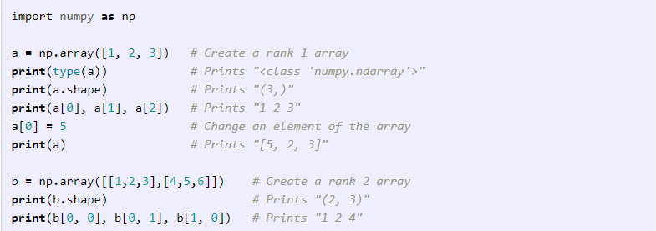
NUMPY -ARRAYS
A numpy array is a grid of values, all of the same type, and is indexed by a tuple of nonnegative integers. The number of dimensions is the rank of the array; the shape of an array is a tuple of integers giving the size of the array along each dimension.
We can initialize numpy arrays from nested Python lists, and access elements using square brackets:

Slide 18
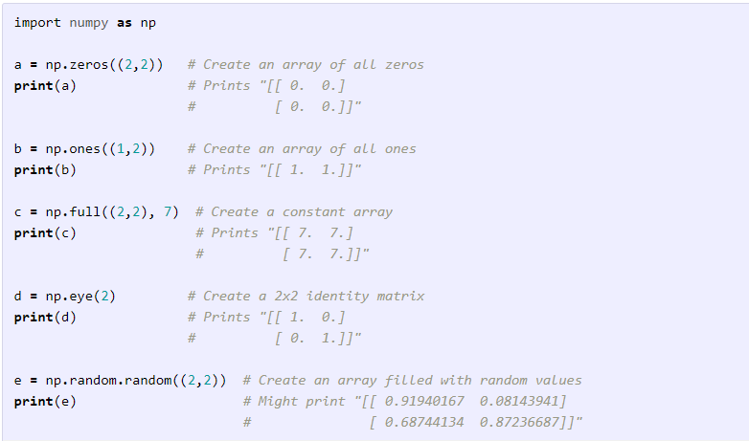
NUMPY -ARRAYS
Numpy also provides many functions to create arrays:

Slide 19
SCIPY Library
SciPy main data structure is again a multidimensional array, implemented by Numpy and extends Numpy capabilities.
The package contains tools that help with solving linear algebra, probability theory, integral calculus and many more tasks.
SciPy faced major build improvements in the form of continuous integration into different operating systems, new functions and methods.
Example
from scipy.constants import pi
print(“SciPy – pi = %.16f”%scipy.constants.pi)
Output:
SciPy – pi = 3.1415926535897931

Slide 20
SciPy Subpackages
Subpackages | Explanation
scipy.cluster | Vector quantization or K Means
scipy.constants | Physical and mathematical constants
scipy.fftpack | Fourier Transform
scipy.integrate | Integration Routines
scipy.interpolate | Interpolation
scipy.io | Data input and output
scipy.linalg | Linear algebra routines
scipy.ndimage | n- dimensional image package
scipy.odr | Orthogonal distance regression
scipy.optimize | Optimization
scipy.signal | Signal processing
scipy.sparse | Sparse matrices
scipy.spatial | Spatial data structures and algorithms
scipy.special | Any special Mathematical functions
scipy.stats | Statistics

Slide 21
Scipy - K means clustering
K means clustering means cluster whose interpoint distances are small is compared with distance to points outside of cluster.
Finding clusters and cluster centers in a set of unlabelled data.
K-means algorithm iterates the following two steps :
For each center a data point that close to it than any other center is identified.
The mean for the data points in each cluster is computed and this mean becomes the new center point of the cluster.

Slide 22
Scipy - K-Means Implementation
Import K-Means
from SciPy.cluster.vq import kmeans,vq,whiten
Data generation
Simulate some data to explore the clustering.
from numpy import vstack,array
from numpy.random import rand
# data generation with three features
data = vstack((rand(100,3) + array([.5,.5,.5]),rand(100,3)))
Output:
array([[ 1.48598868e+00, 8.17445796e-01, 1.00834051e+00],
[ 8.45299768e-01, 1.35450732e+00, 8.66323621e-01],
[ 1.27725864e+00, 1.00622682e+00, 8.43735610e-01], )

Slide 23
Scipy - K-Means Implementation- Cont
It is beneficial to rescale each feature dimension of the observation set with whitening.
Whiten the data
# whitening of data
data = whiten(data)
Compute K-Means with Three Clusters
# computing K-Means with K = 3 (2 clusters)
centroids,_ = kmeans(data,3)
Print the output
print(centroids)
Output:
print(centroids)[ [ 2.26034702 1.43924335 1.3697022 ]
[ 2.63788572 2.81446462 2.85163854]
[ 0.73507256 1.30801855 1.44477558] ]

Slide 24
Scipy Constants
List of Constants
Mathematical Constant
Pi
golden - Golden ratio
Physical constant
c – Speed of light in vaccum
Planck – Planck’s Constant h
G – Newton’s gravitational constant
e – Elementary charge
R – Molar gas constant
Avogadro – Avogadro constant
k – Boltzmann constant

Slide 25
Scipy Constants - Cont
Function to know which key is for which constant is scipy.constants.find()
Example
import scipy.constants
res = scipy.constants.physical_constants["alpha particle mass"]
print res
Output :
[ 'alpha particle mass',
'alpha particle mass energy equivalent',
'alpha particle mass energy equivalent in MeV',
'alpha particle mass in u',
'electron to alpha particle mass ratio' ]

Slide 26
PANDAS
Pandas is a Python library that provides high-level data structures and a vast variety of tools for analysis.
The great feature of this package is the ability to translate rather complex operations with data into one or two commands.
Pandas contains many built-in methods for grouping, filtering, and combining data, as well as the time-series functionality.
There have been a few new releases of the pandas library, including hundreds of new features, enhancements, bug fixes, and API changes.

Slide 27
PANDAS
EXAMPLE:
dict = {"country": ["Brazil", "Russia", "India", "China", "South Africa"],
"capital": ["Brasilia", "Moscow", "New Dehli", "Beijing", "Pretoria"],
"area": [8.516, 17.10, 3.286, 9.597, 1.221],
"population": [200.4, 143.5, 1252, 1357, 52.98] }
import pandas as pd
brics = pd.DataFrame(dict)
print(brics)
OUTPUT:
area capital country population
0 8.516 Brasilia Brazil 200.40
1 17.100 Moscow Russia 143.50
2 3.286 New Dehli India 1252.00
3 9.597 Beijing China 1357.00
4 1.221 Pretoria South Africa 52.98

Slide 28
SCIKIT LEARN
Scikit-learn is based on NumPy and SciPy is one of the best libraries for working with data.
It provides algorithms for many standard machine learning and data mining tasks such as clustering, regression, classification, dimensionality reduction, and model selection.
The cross validation has been modified, providing an ability to use more than one metric.
Scikit-Learn comes with a few standard datasets.
Several training methods like nearest neighbors and logistic regressions faced some minor improvements.

Slide 29
SCIKIT LEARN
EXAMPLE 1: Sample code to import datasets from sklearn library.
SCIKIT LEARN comes with a few standard datasets.
The iris and digits datasets for classification and the boston house prices dataset for regression.
A dataset is a dictionary-like object that holds all the data and some metadata about the data. This data is stored in the .data member, which is a n_samples, n_features array.
In the case of supervised problem, one or more response variables are stored in the .target member.

Slide 30
SCIKIT LEARN
EXAMPLE 1: Sample code to import datasets from sklearn library.
CODE:
$ python
>>> from sklearn import datasets
>>> iris = datasets.load_iris()
>>> digits = datasets.load_digits()
>>> print(digits.data)
>>> digits.target

Slide 31
SCIKIT LEARN
EXAMPLE 1: Sample code to import datasets from sklearn library.
OUTPUT:
digits.data | digits.target
[[ 0. 0. 5. ... 0. 0. 0.] [ 0. 0. 0. ... 10. 0. 0.] [ 0. 0. 0. ... 16. 9. 0.] ... [ 0. 0. 1. ... 6. 0. 0.] [ 0. 0. 2. ... 12. 0. 0.] [ 0. 0. 10. ... 12. 1. 0.]] | array([0, 1, 2, ..., 8, 9, 8])

Slide 32
SCIKIT LEARN
Explanation of example 1 code lines
$ denotes the shell prompt.
>>> denotes the Python interpreter prompt.
Import the datasets of iris and digits.
digits.data gives access to the features that can be used to classify the digits samples.
digits.target gives the ground truth for the digit dataset, that is the number corresponding to each digit image.

Slide 33
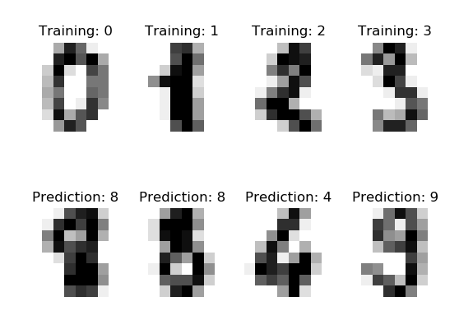
SCIKIT LEARN
Example 2: Recognizing hand-written digits
This example showing how the scikit-learn can be used to recognize images of hand-written digits

Slide 34
SCIKIT LEARN
Example 2: Recognizing hand-written digits
CODE:
print(__doc__)
import matplotlib.pyplot as plt # Standard scientific Python import
from sklearn import datasets, svm, metrics # Import datasets, classifiers and
# performance metrics
digits = datasets.load_digits() # The digits dataset
# The data that we are interested it is made of 8x8 images of digits, let's have a look at # the first 4 images, stored in the `images` attribute of the dataset. If we were working # from image files, we could load them using matplotlib.pyplot.imread. Note that
# each image must have the same size. For these images, we know which digit they
# represent: it is given in the 'target' of the dataset.

Slide 35
SCIKIT LEARN
Example 2: Recognizing hand-written digits (Code Cont…)
images_and_labels = list(zip(digits.images, digits.target))
for index, (image, label) in enumerate(images_and_labels[:4]):
plt.subplot(2, 4, index + 1)
plt.axis('off')
plt.imshow(image, cmap=plt.cm.gray_r, interpolation='nearest')
plt.title('Training: %i' % label)
# To apply a classifier on this data, we need to flatten the image, tom turn the data in a # (samples, feature) matrix:
n_samples = len(digits.images)
data = digits.images.reshape((n_samples, -1))

Slide 36
SCIKIT LEARN
Example 2: Recognizing hand-written digits (Code Cont…)
# Create a classifier: a support vector classifier
classifier = svm.SVC(gamma=0.001)
# We learn the digits on the first half of the digits
classifier.fit(data[:n_samples // 2], digits.target[:n_samples // 2])
# Now predict the value of the digit on the second half:
expected = digits.target[n_samples // 2:]
predicted = classifier.predict(data[n_samples // 2:])
print("Classification report for classifier %s:\n%s\n"
% (classifier, metrics.classification_report(expected, predicted)))

Slide 37
SCIKIT LEARN
Example 2: Recognizing hand-written digits (Code Cont…)
print("Confusion matrix:\n%s" % metrics.confusion_matrix(expected, predicted))
images_and_predictions = list(zip(digits.images[n_samples // 2:], predicted))
for index, (image, prediction) in enumerate(images_and_predictions[:4]):
plt.subplot(2, 4, index + 5)
plt.axis('off')
plt.imshow(image, cmap=plt.cm.gray_r, interpolation='nearest')
plt.title('Prediction: %i' % prediction)
plt.show()

Slide 38
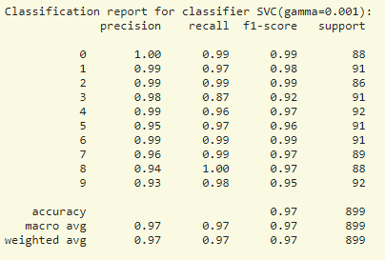
SCIKIT LEARN
Example 2: Recognizing hand-written digits (Cont…)
OUTPUT:

Slide 39
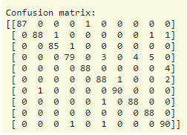
SCIKIT LEARN
Example 2: Recognizing hand-written digits (Cont…)
OUTPUT:

Slide 40
VISUALIZATION - MATPLOTLIB
Matplotlib is a low-level library for creating two-dimensional diagrams and graphs.
With its help, you can build diverse charts, from histograms and scatterplots to non-Cartesian coordinates graphs.
Moreover, many popular plotting libraries are designed to work in conjunction with matplotlib.
There have been style changes in colors, sizes, fonts, legends, etc.
As an example of an appearance improvements are an automatic alignment of axes legends and among significant colors improvements is a new colorblind-friendly color cycle.

Slide 41
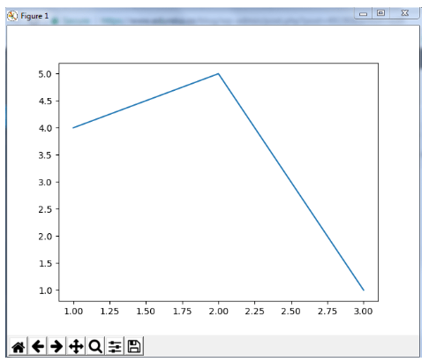
VISUALIZATION - MATPLOTLIB
EXAMPLE:
from matplotlib import pyplot as plt
#Plotting to our canvas
plt.plot([1,2,3],[4,5,1])
#Showing what we plotted
plt.show()
OUTPUT:

Slide 42
PYTHON WITH HADOOP AND SPARK

Slide 43
What is Hadoop?
Hadoop is an open source framework from Apache and is used to store process and analyze data which are very huge in volume.
Hadoop is written in Java and is not OLAP (online analytical processing).
It is used for batch/offline processing.
It is being used by Facebook, Yahoo, Google, Twitter, LinkedIn and many more.

Slide 44
MODULES OF HADOOP
HDFS: Hadoop Distributed File System states that the files will be broken into blocks and stored in nodes over the distributed architecture.
Yarn: Used for job scheduling and manage the cluster.
Map Reduce: This is a framework which helps Java programs to do the parallel computation on data using key value pair. The Map task takes input data and converts it into a data set which can be computed in Key value pair. The output of Map task is consumed by reduce task and then the out of reducer gives the desired result.
Hadoop Common: These Java libraries are used to start Hadoop and are used by other Hadoop modules.

Slide 45
What is MapReduce?
A Map Reduce is a data processing tool which is used to process the data parallel in a distributed form
The Map Reduce is a paradigm which has two phases,
The Mapper phase
The Reducer phase
Mapper: The input is given in the form of a key-value pair. The output of the Mapper is fed to the reducer as input.
Reducer: Runs only after the Mapper is over. The reducer too takes input in key-value format, and the output of reducer is the final output.

Slide 46
STEPS IN MAP REDUCE
The map takes data in the form of pairs and returns a list of <key, value> pairs. The keys will not be unique in this case.
Using the output of Map, sort and shuffle are applied by the Hadoop architecture. This sort and shuffle acts on these list of <key, value> pairs and sends out unique keys and a list of values associated with this unique key <key, list(values)>.
An output of sort and shuffle sent to the reducer phase. The reducer performs a defined function on a list of values for unique keys, and Final output <key, value> will be stored/displayed.

Slide 47
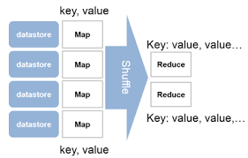
MAPREDUCE STEPS

Slide 48
HADOOP STREAMING
Hadoop streaming is a utility that comes packaged with the Hadoop distribution and allows Map Reduce jobs to be created with any executable as the mapper and/or the reducer. The Hadoop streaming utility enables Python, shell scripts, or any other language to be used as a mapper, reducer, or both.

Slide 49
WORDCOUNT APPLICATION USING PYTHON
Word Count application can be implemented as two Python programs:
mapper.py .
reducer.py.
mapper.py is the Python program that implements the logic in the map phase of Word Count. It reads data from stdin, splits the lines into words, and outputs each word with its intermediate count to stdout.

Slide 50
EXAMPLE PROGRAM - Mapper.py
#!/usr/bin/env python
import sys
# Read each line from stdin
Hadoop Streaming | 19
for line in sys.stdin:
# Get the words in each line
words = line.split()
# Generate the count for each word
for word in words:
# Write the key-value pair to stdout to be processed by
# the reducer.
# The key is anything before the first tab character and the
#value is anything after the first tab character.
print '{0}\t{1}'.format(word, 1)

Slide 51
EXAMPLE PROGRAM - Reducer.py
#!/usr/bin/env python
import sys
curr_word = None
curr_count = 0 # Process each key-value pair from the mapper
for line in sys.stdin: # Get the key and value from the current line
word, count = line.split('\t') # Convert the count to an int
count = int(count) # If the current word is the same as the previous word,
# increment its count, otherwise print the words count
if word == curr_word:
curr_count += count
else: # Write word and its number of occurrences as a key-value
if curr_word:
print '{0}\t{1}'.format(curr_word, curr_count)
curr_word = word

Slide 52
SPARK

Slide 53
SPARK
Spark is a cluster computing framework that uses in-memory primitives to enable programs to run up to a hundred times faster than Hadoop MapReduce applications.
Spark applications consist of a driver program that controls the execution of parallel operations across a cluster.
The main programming abstraction provided by Spark is known as Resilient Distributed Datasets (RDDs).
RDDs are collections of elements partitioned across the nodes of the cluster that can be operated on in parallel.

Slide 54
RDD - RESILIENT DISTRIBUTED DATASET
The RDD (Resilient Distributed Dataset) is the Spark's core abstraction. It is a collection of elements, partitioned across the nodes of the cluster so that we can execute various parallel operations on it.
There are two ways to create RDDs:
Parallelized Collections- Parallelizing an existing data in the driver program
External Datasets- Referencing a dataset in an external storage system, such as a shared file system, HDFS, HBase, or any data source offering a Hadoop InputFormat.

Slide 55
WAYS TO CREATE RDD’S
Parallelized Collections
To create parallelized collection, call SparkContext's parallelize method on an existing collection in the driver program. Each element of collection is copied to form a distributed dataset that can be operated on in parallel.
val info = Array(1, 2, 3, 4)
val distinfo = sc.parallelize(info)

Slide 56
WAYS TO CREATE RDD’S
External Datasets
In Spark, the distributed datasets can be created from any type of storage sources supported by Hadoop such as HDFS, Cassandra, HBase and even our local file system. Spark provides the support for text files, SequenceFiles, and other types of Hadoop InputFormat.
SparkContext's textFile method can be used to create RDD's text file. This method takes a URI for the file (either a local path on the machine or a hdfs://) and reads the data of the file.

Slide 57
RDD Operations
The RDD provides the two types of operations:
1. Transformation
2. Action
Transformation
In Spark, the role of transformation is to create a new dataset from an existing one. The transformations are considered lazy as they only computed when an action requires a result to be returned to the driver program.
Examples : map(func), filter(func), flatMap(func)

Slide 58
RDD Operations
Action
In Spark, the role of action is to return a value to the driver program after running a computation on the dataset.
Examples : reduce(func),collect(),count(),first()

Slide 59
WORDCOUNT IN PYSPARK
The code implements the WordCount algorithm in PySpark. It assumes that a data file, input.txt, is loaded in HDFS under /user/hduser/input, and the output will be placed in HDFS under /user/hduser/output.
Example code:
from pyspark import SparkContext
def main():
sc = SparkContext(appName='SparkWordCount')
input_file = sc.textFile('/user/hduser/input/input.txt')
counts = input_file.flatMap(lambda line: line.split()) \
.map(lambda word: (word, 1)) \
.reduceByKey(lambda a, b: a + b)
counts.saveAsTextFile('/user/hduser/output')
sc.stop()
if __name__ == '__main__':
main()

Slide 60

Summary
In this module, we have learnt about the following,
Python basics
Variables types
Data types
Libraries
Python with Hadoop and spark

Slide 61
THANK YOU!!!

